Slide 1
IE 411/511:
Visual Programming for Industrial Applications
Lecture Notes #8
Methods

Slide 2
Module Learning Objectives
In this chapter you will learn:
To construct programs modularly from methods
  Subroutines
  Functions
The mechanisms used to pass information between methods

Slide 3
Introduction
The best way to develop and maintain large programs is to construct them from small, simple pieces
  Divide and conquer
In this module, we formalize our discussion of methods and use them to facilitate the design, implementation, operation and maintenance of larger programs

Slide 4
Introduction (cont.)
You write methods to define specific tasks that a program may use one or more times during its execution
  Although the same method can be executed from multiple points in a program, the actual statements that define the method are written only once
A method is invoked by a method call
  The method call specifies the method name and provides information
  When the method completes its task, it returns control to the caller
In some cases, the method also returns a result to the caller

Slide 5
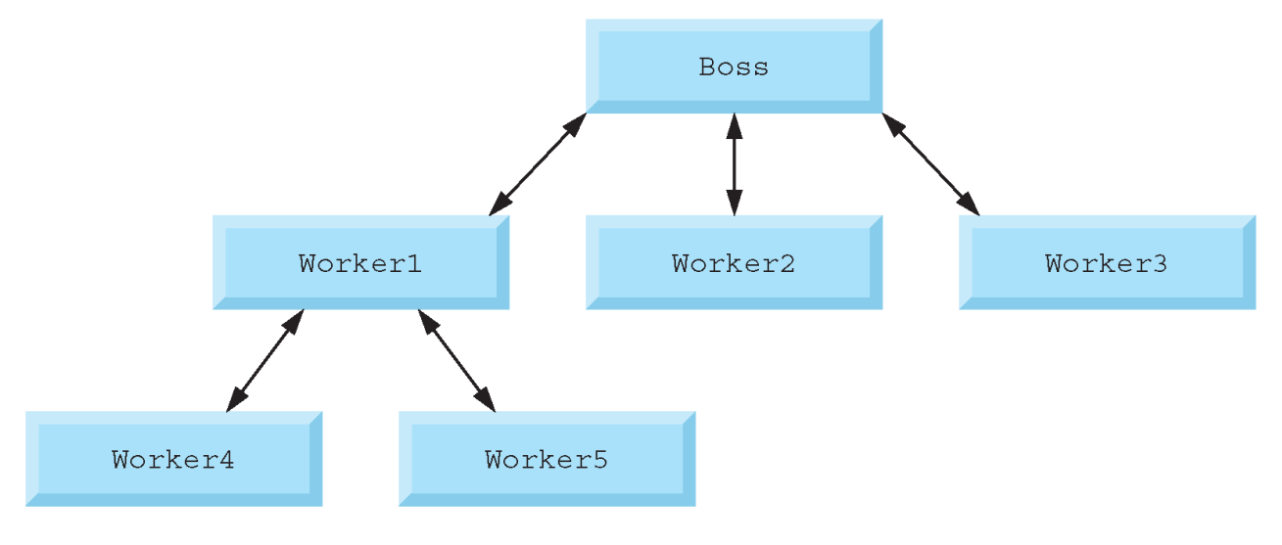
Introduction (cont.)
A boss (the caller) asks a worker (the callee) to perform a task and return the results when the task is done
The worker might call other workers
  However, the boss would be unaware of this

Slide 6
Introduction (cont.)
To promote reusability, the capabilities of each method should be limited to the performance of a single, well-defined task
  Also, the name of the method should express that task effectively
If you cannot choose a concise method name that expresses the task performed by a method, the method could be attempting to perform too many diverse tasks
  Consider dividing such a method into several smaller methods

Slide 7
Subroutines
Subroutines are methods that do NOT return a value
The format of a subroutine declaration is:
The parameter-list is a comma-separated list of each parameter’s type and name
  There must be one argument in the method call for each parameter in the method declaration
  The type of each argument must be consistent with its corresponding parameter’s type
  If a method does not receive any values, the method name is followed by an empty set of parentheses
Sub method-name(parameter-list)
Declarations and statements
End Sub

Slide 8
Subroutines (cont.)
The method body (also referred to as a block) contains declarations and statements
  The body of a method declared with Sub must be terminated with End Sub
Method names tend to be verbs because methods typically perform actions
  By convention, method names begin with an uppercase letter and all subsequent words in the name begin with a capital letter
    e.g., CalculatePayment, EstimateTime, GenerateLayout
Small methods are easier to test, debug and understand than large methods

Slide 9
Subroutines (cont.)
Declaring a variable in the method’s body with the same name as a parameter variable in the method header will result in a compilation error
Although it is allowable, an argument passed to a method should not have the same name as the corresponding parameter name in the method declaration
  This prevents ambiguity that could lead to logic errors

Slide 10
Subroutine Example
Consider the following problem statement:
Employees’ weekly salaries are based on the number of hours they worked and their hourly wage. Create an app that accepts this information for one employee then calculates and displays the employee’s total (gross) earnings. Assume a standard work week of 40 hours. The wages for 40 or fewer hours are calculated by multiplying the hourly wage by the number of hours worked. Hours over 40 hours are considered “overtime” and earn “time and a half.” Salary for time and a half is calculated by multiplying the employee’s hourly wage by 1.5 and multiplying the result of that calculation by the number of overtime hours worked. The overtime pay is added to the user’s gross earnings for the regular 40 hours of work to calculate the total earnings for that week.

Slide 11
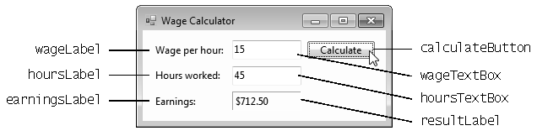
Subroutine Example (cont.)
GUI for Wage Calculator app

Slide 12
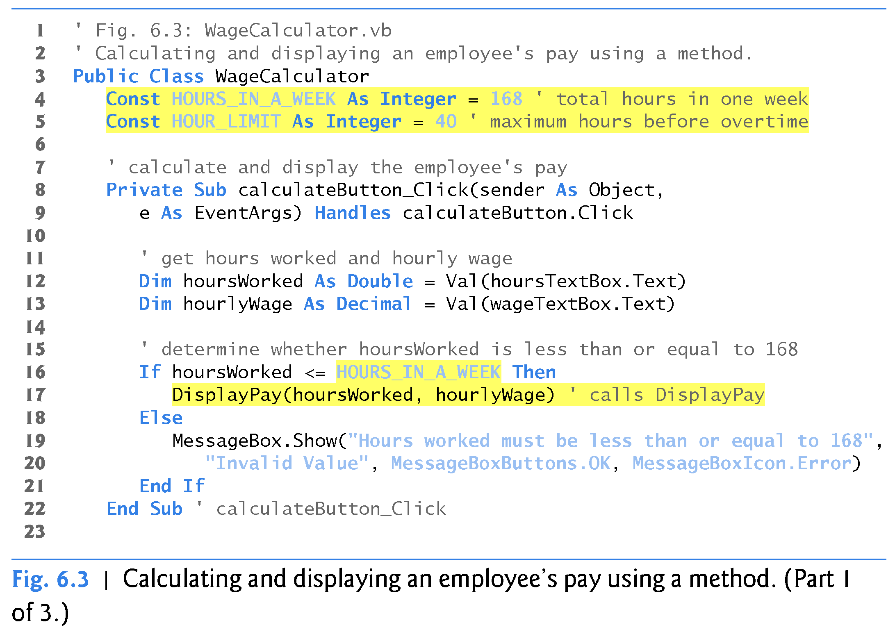
Subroutine Example (cont.)

Slide 13
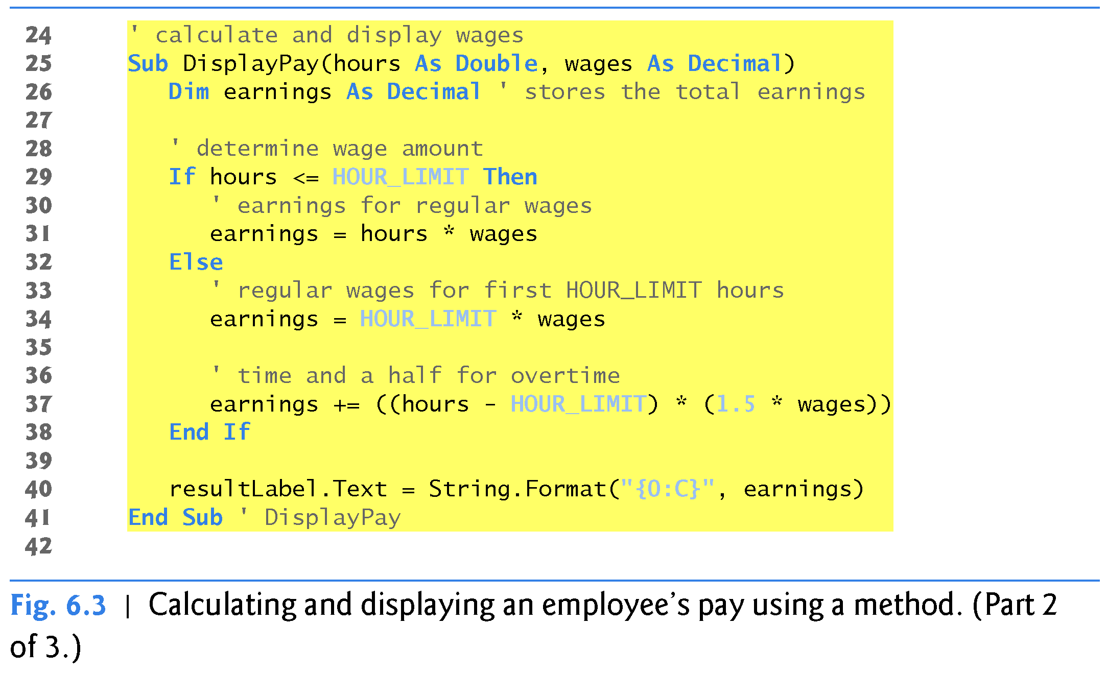
Subroutine Example (cont.)

Slide 14
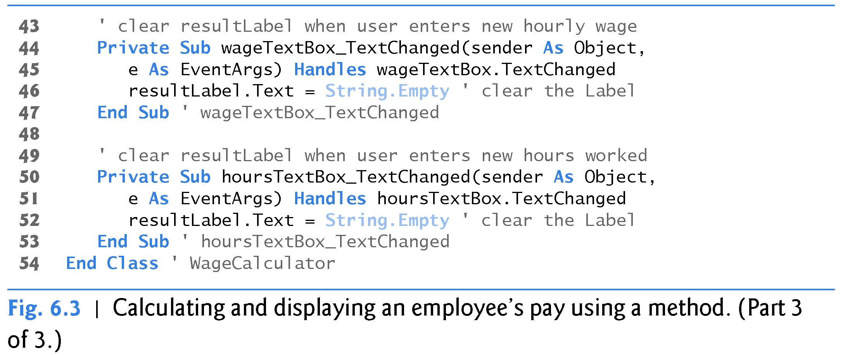
Subroutine Example (cont.)

Slide 15
Functions
Functions are methods that return a value
to the caller
The format of a function declaration is
The method-name, parameter-list, and declarations and statements in a function declaration behave like the corresponding elements in a subroutine declaration
Function method-name(parameter-list) As return-type
Declarations and statements
Return expression
End Function

Slide 16
Functions (cont.)
In the function header, the return-type indicates the type of the value returned from the function to its caller
The Return statement terminates the method and returns the result
The return statement can occur anywhere in the body of a function
  Return expression
When a Return statement executes, control returns immediately to the point at which that function was invoked

Slide 17
Functions (cont.)
If the expression in a Return statement cannot be converted to the function’s return-type, a run­time error is generated
Failure to return a value from a function (e.g., by forgetting to provide a Return statement) causes the function to return the default value for the return-type, possibly producing incorrect output

Slide 18
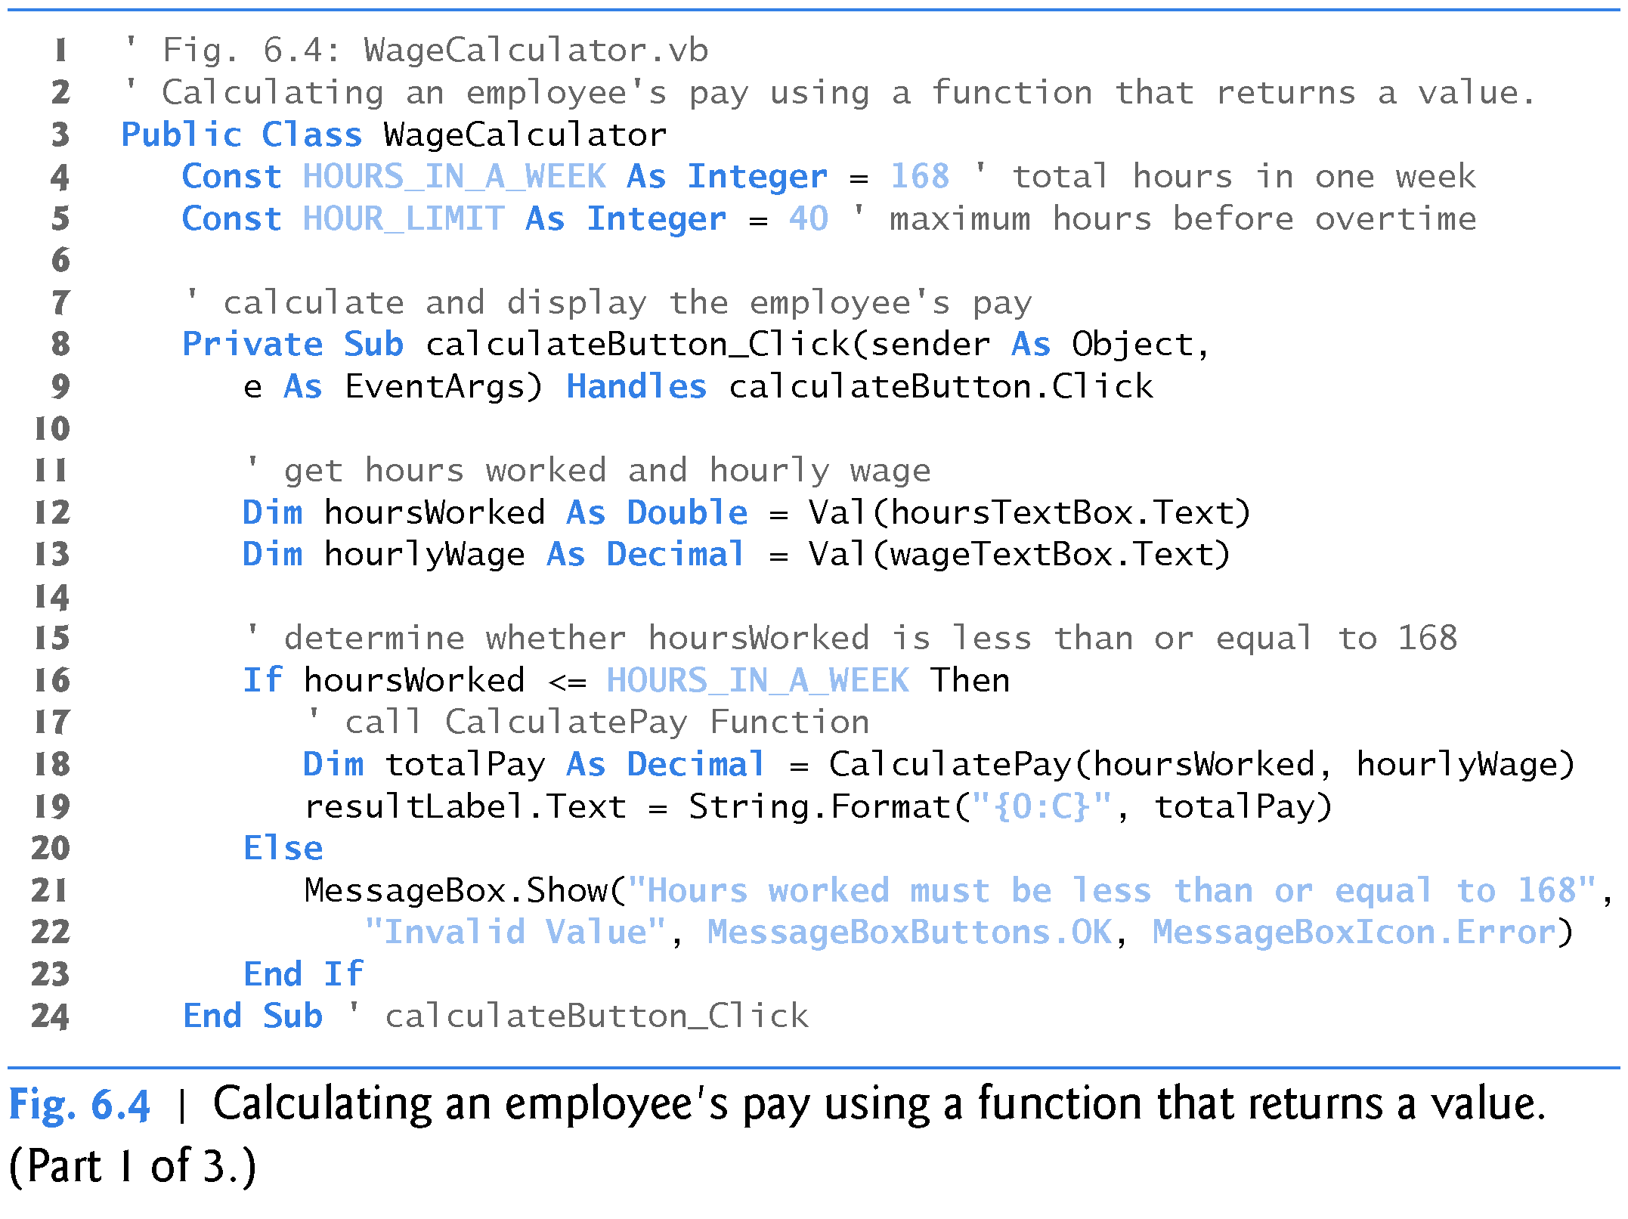
Function Example

Slide 19
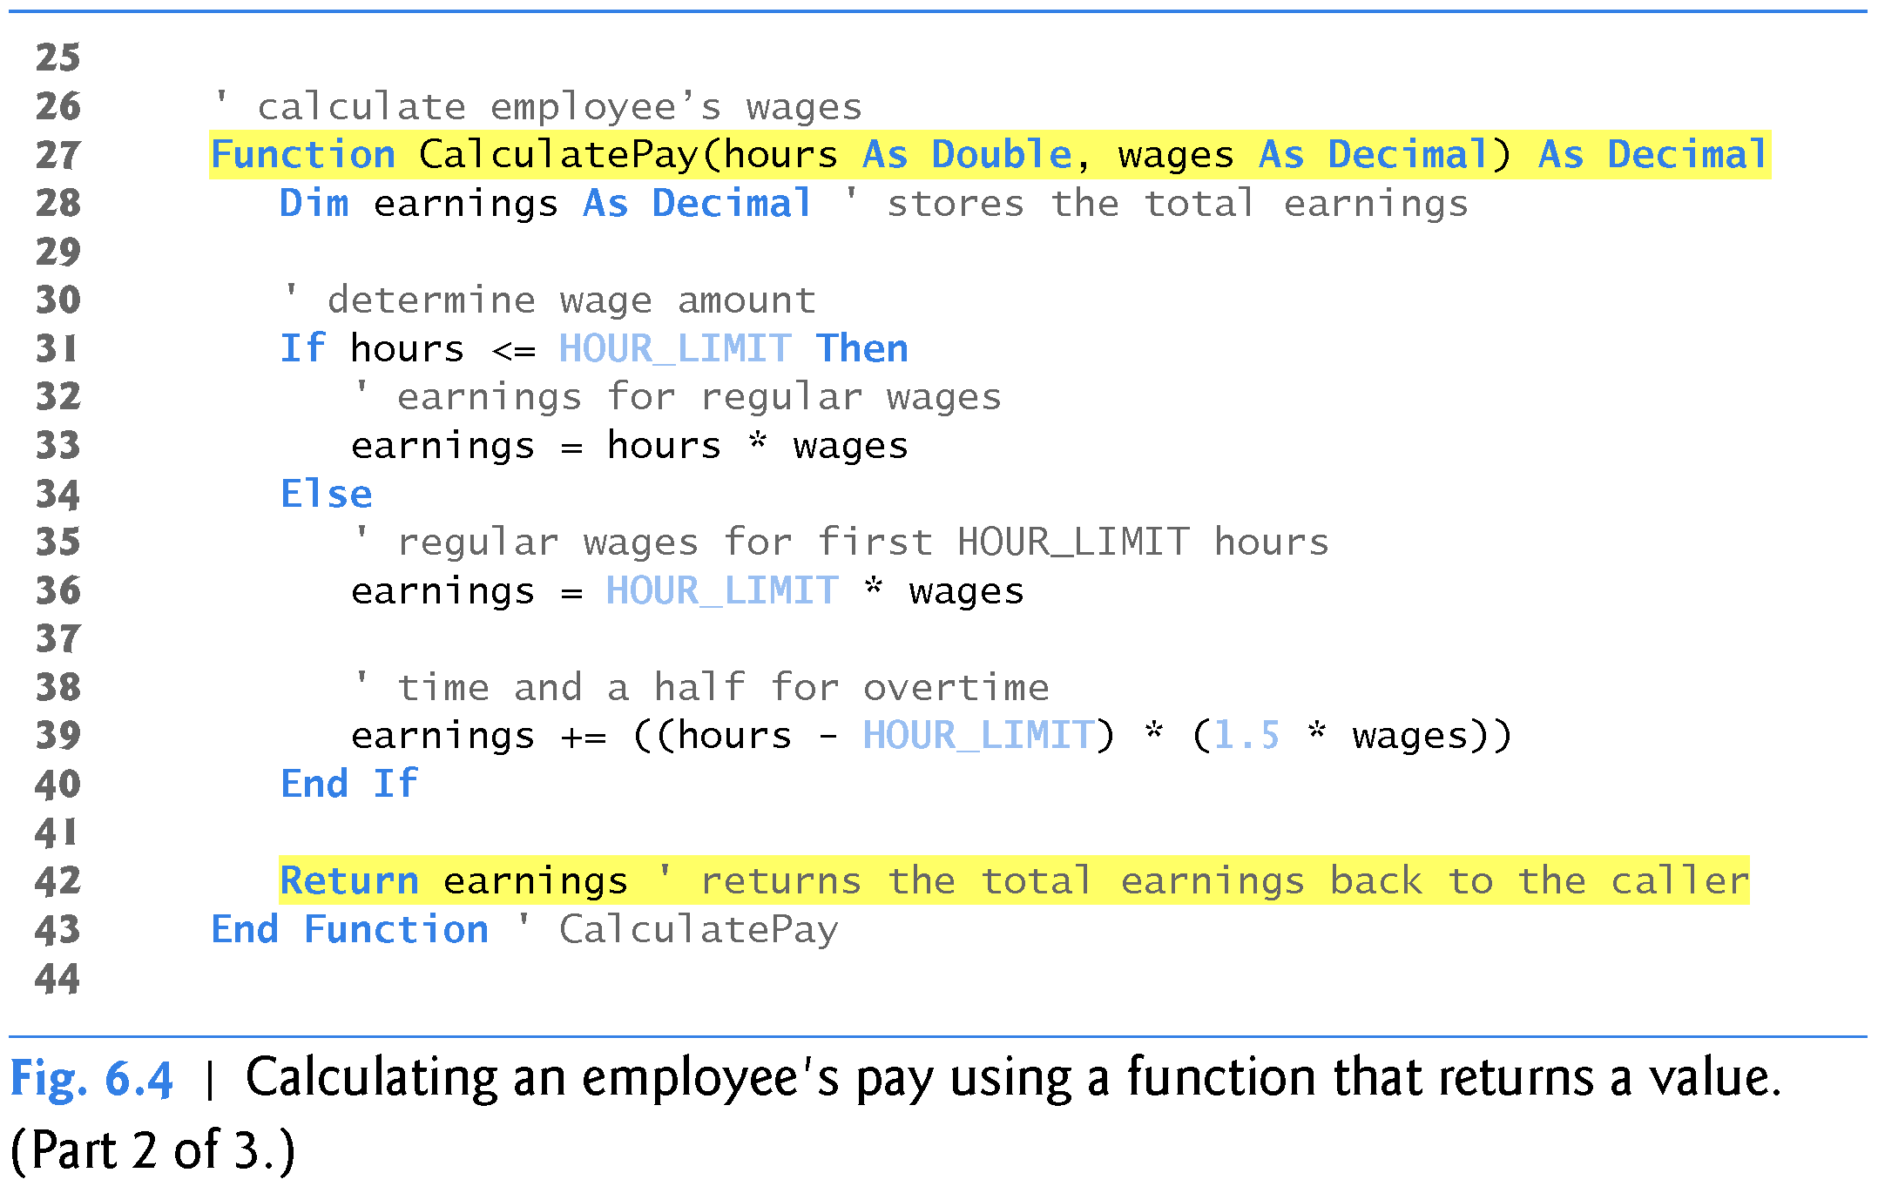
Function Example (cont.)

Slide 20
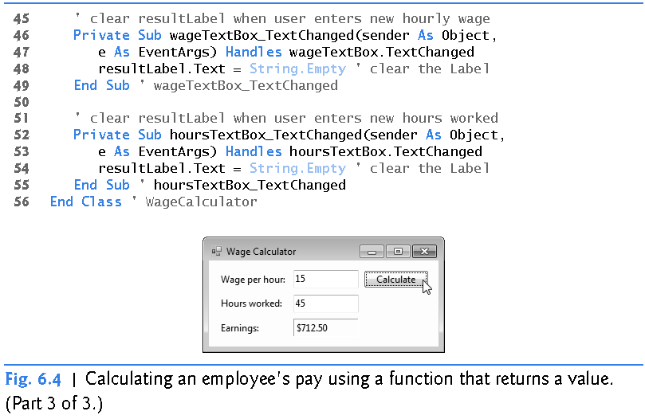
Function Example (cont.)

Slide 21
Notes on Declaring and Using Methods
Common Programming Errors with Methods
Declaring a method outside the body of a class or module declaration or inside the body of another method is a syntax error
Omitting the return-value-type in the declaration of a function is a syntax error
Re-declaring a method parameter as a local variable in the method’s body is a compilation error
Returning a value from a method that is a subroutine is a compilation error

Slide 22
Passing Arguments
Arguments are passed pass-by-value or
pass-by-reference
When an argument is passed by value, the program makes a copy of the argument’s value and passes the copy
  Changes to the copy do not affect the original variable
When an argument is passed by reference, the original data can be accessed and modified directly

Slide 23
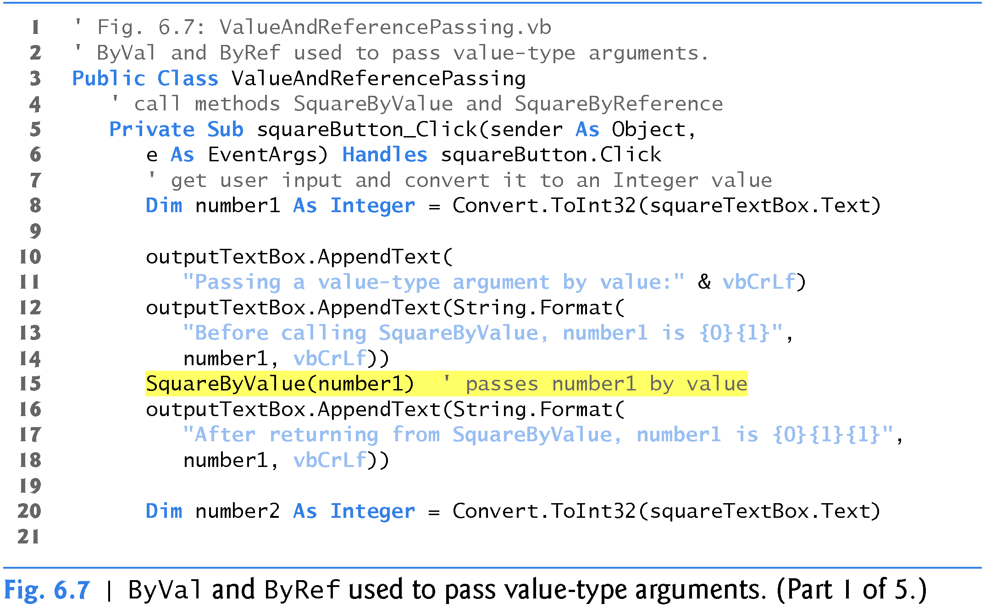
Passing Arguments (cont.)
The following program demonstrates passing arguments by value and by reference

Slide 24
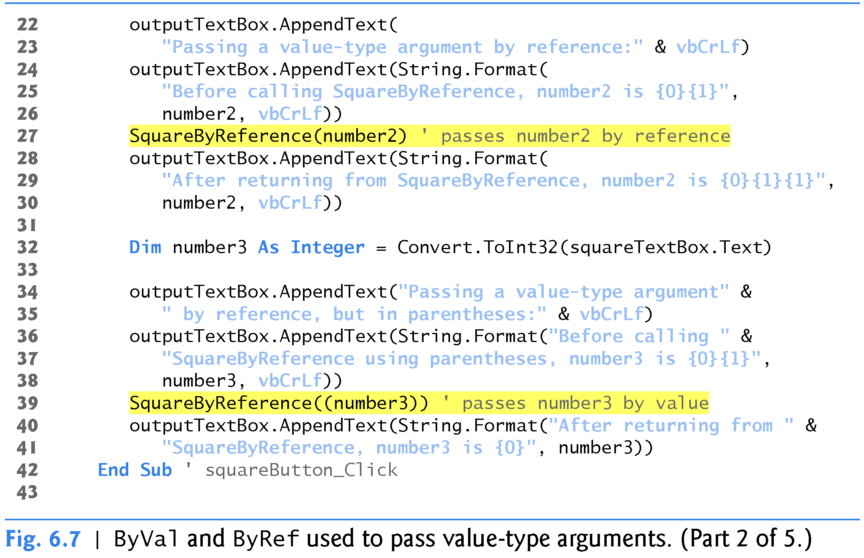
Passing Arguments (cont.)
The following program demonstrates passing arguments by value and by reference

Slide 25
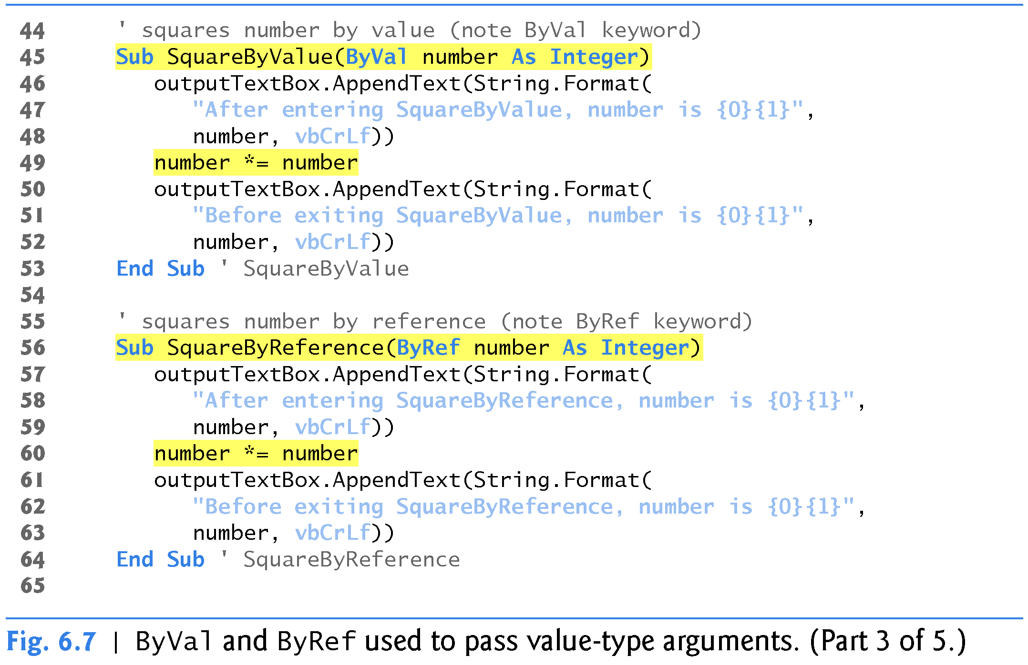
Passing Arguments (cont.)
The following program demonstrates passing arguments by value and by reference

Slide 26
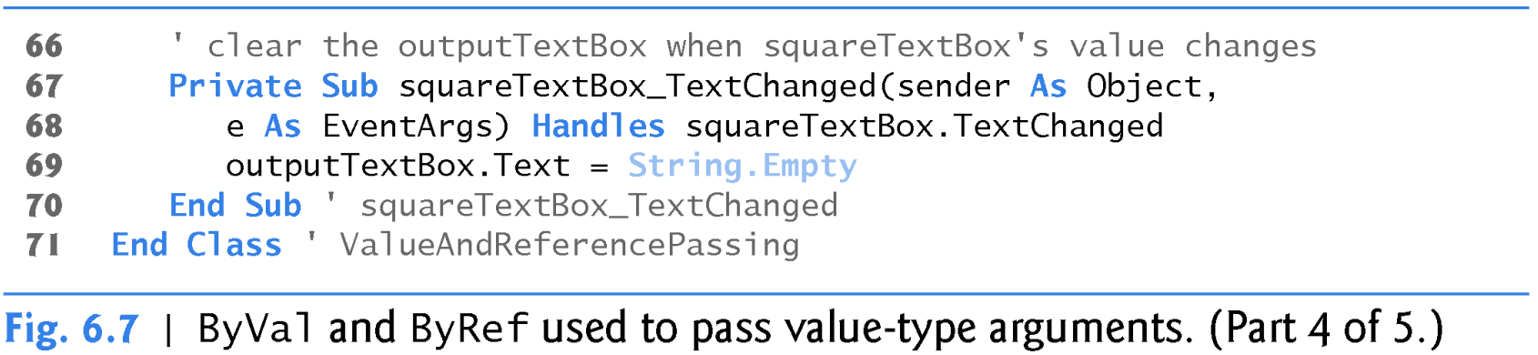
Passing Arguments (cont.)
The following program demonstrates passing arguments by value and by reference

Slide 27
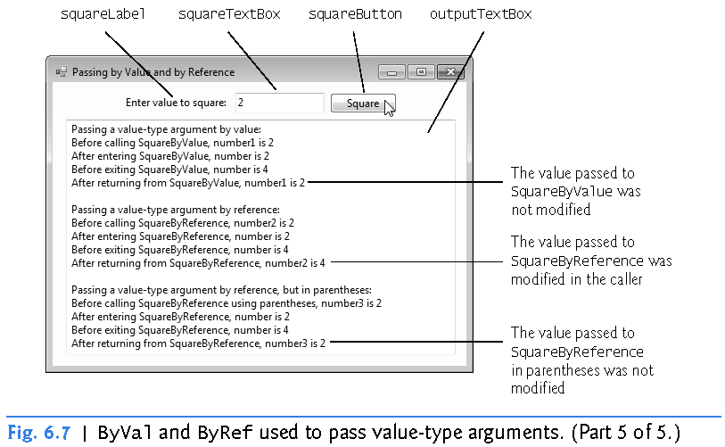
Passing Arguments (cont.)
The following program demonstrates passing arguments by value and by reference (4 of 5)

Slide 28
Passing Arguments (cont.)
When passing arguments by value, changes to the called method’s copy do not affect the original variable’s value
  This prevents possible side effects that could hinder the development of correct and reliable software systems
Always pass value-type arguments by value unless you explicitly intend for the called method to modify the caller’s data

Slide 29
Implicit Argument Conversions
An important feature of argument passing is implicit argument conversion
  Visual Basic converts an argument’s value to the type that the method expects to receive in its corresponding parameter
Widening and narrowing conversions are supported
  A widening conversion occurs when an argument is converted to a parameter of another type that can hold more data
  A narrowing conversion occurs when there is potential for data loss during the conversion (i.e., a conversion to a parameter of a type that holds a smaller amount of data)

Slide 30
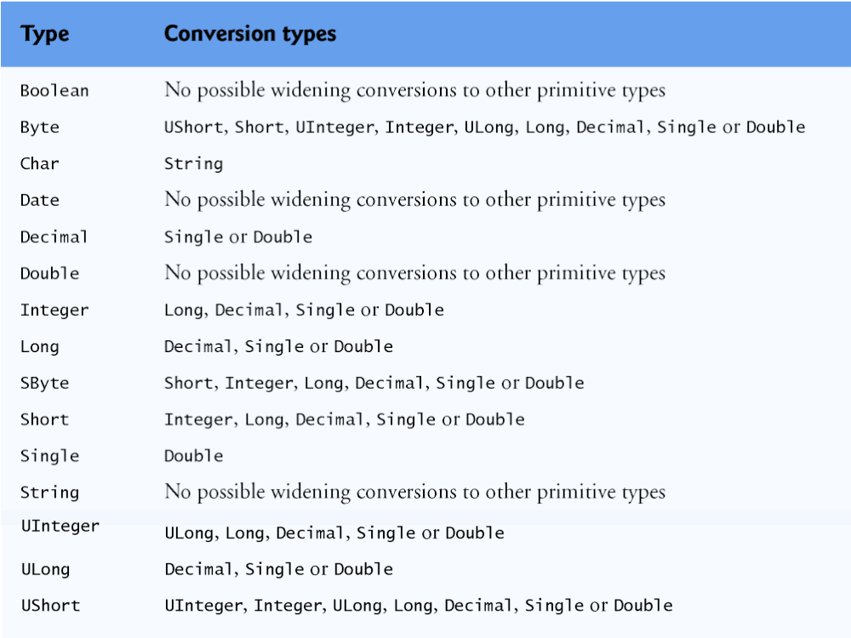
Implicit Argument Conversions (cont.)
Widening conversions that occur between primitive types

